Slide 1
Flink

Slide 2
Background
Flink is what is known as a stream processing framework. It is not a message broker, but instead rather software run on a cluster of nodes used as consumers of some message broker.
Flink is useful as it allows distributed processing of a message queue (in real time as opposed to micro batching), while also persisting state about the seen messages amongst the nodes in a cluster in order to make meaningful aggregations or joins on incoming data.

Slide 3
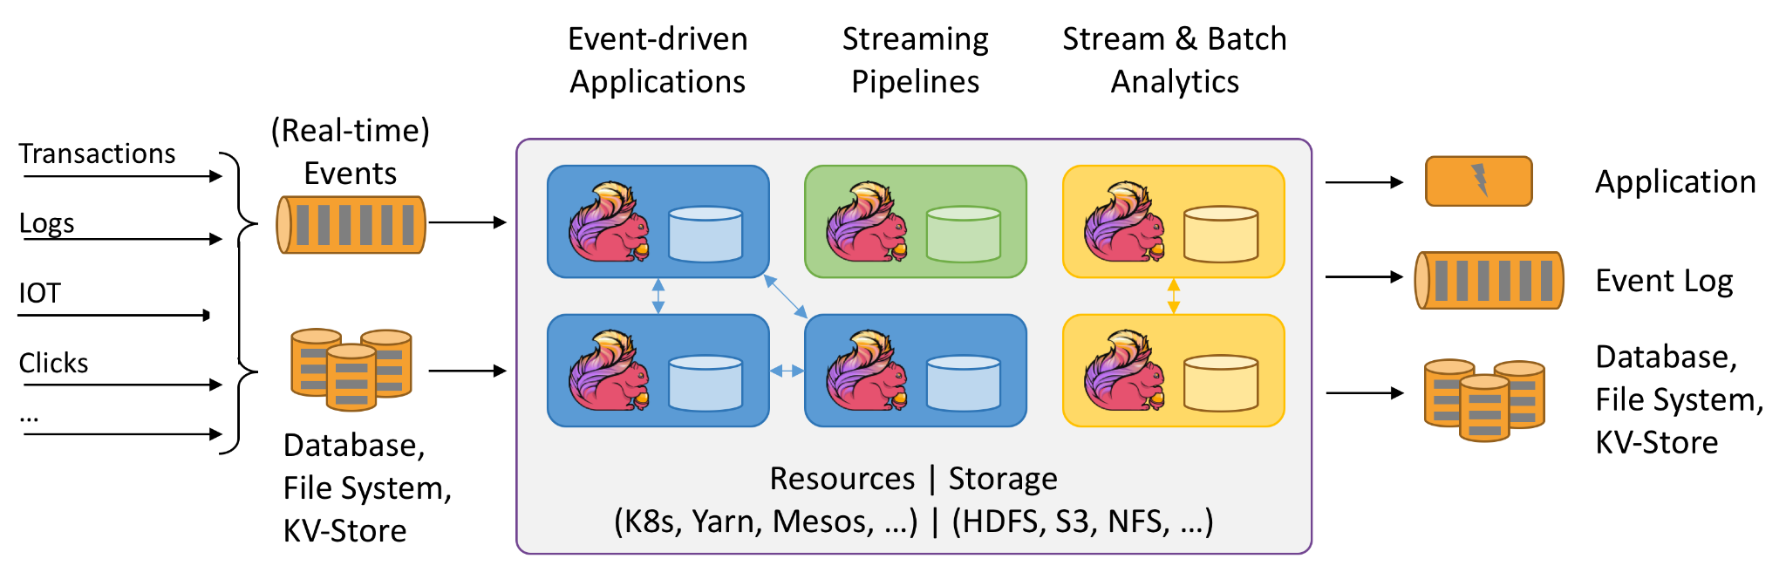
Use Case Visualized

Slide 4
State in Stream Processing
Why is it so important to keep state if each event should be processed independently?
Grouping events by time
Holding a local copy of a database table for stream enrichment
Table updated over time by ingesting changes from a stream
Tinder use case example
Every like placed into a stream, Flink processes likes and stores them in state, if a like comes in with the opposite directional like already in state, we have a match
Flink forwards match data into a second stream

Slide 5
Fault Tolerance
Each node has its own built up local state that it computes based on the messages that it uniquely sees (messages are hashed such that they only go to one node in the cluster, it is the developer’s job to make sure they are partitioned correctly).
So each node has its own local state, and we want to make sure that if one of the nodes crashes, we can recover its local state as well as process any messages that it had yet to process on a new node. It does so by occasionally storing checkpoints of node state to durable storage such as HDFS or S3!

Slide 6
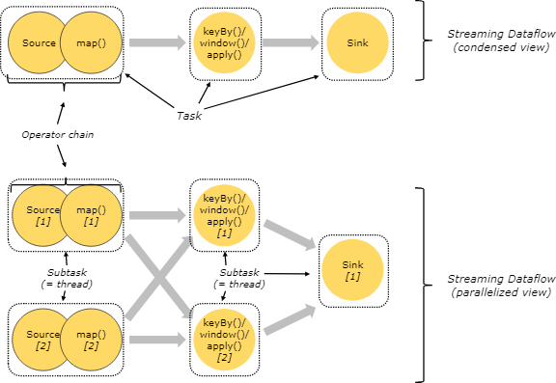
Flink Architecture
Obviously, in order to increase performance, Flink tries to parallelize computation as much as possible.
Single Job Manager node
Responsible for parallelizing a given job into work for each Task Manager using dataflow graph
Responsible for initiating checkpoints, and storing where they are located in distributed file system
Can achieve high availability on job manager by using a coordination service for keeping track of which nodes are up and which are not, as well as status of which checkpoints have worked

Slide 7
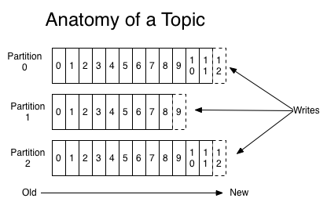
Log Based Message Brokers
Recall: Log Based Message Brokers are partitioned and persistent message queues that keep track of the offset of the last message that a consumer node has seen. Messages are delivered in order to a single consumer.
Flink uses log based message brokers such as kafka as its data source.

Slide 8
Checkpointing
Job Manager occasionally sends “checkpoint barrier” message to all nodes in cluster
Checkpoint barrier delivered in order to all consumers, since it is treated like any other message in the log based message queue (which delivers messages in order)
Upon processing checkpoint barrier consumers note their current offset in the log based message broker, and persist this along with their local state to distributed storage
Using Chandy Lamport distributed snapshots (consistent with causality)
If a node crashes, restore all nodes to a checkpointed state, and start processing messages from corresponding offsets
May result in certain messages being processed more than once!
Snapshots created in the background (non-blocking), considered successful if all nodes report successfully storing local snapshot to job manager

Slide 9
Changing Cluster Size
If we want to change the size of our cluster, we have to redistribute state over the nodes. Similarly to consistent hashing, we want to ensure that as little state as possible is redistributed over the network while ensuring that each node processes a similar amount. To do this, Flink has made an adjustment such that checkpoints are just lists of keys and values (as opposed to individual objects representing the state on each node), so that this way they can be easily re-partitioned using some sort of range schema.

Slide 10
Conclusion
Unlike a Spark Streaming, which processes messages in microbatches, Flink is a fully real time stream processing engine that provides the ability to make stateful computations with high availability. In comparison to other stream processing engines like Apache Storm or Samza, Flink makes life easier for the developer by automatically calculating the dataflow graph, and parallelizing work for you.

